Slide 1
Chapter 16
The System.IO namespace

Slide 2
Objectives
Explore the core types defined in the System.IO namespace
How to programmatically modify a machine's directory and file structure
Explore various ways to read from and write to character-based, binary-based, string-based, and memory-based data stores

Slide 3
Content
Displaying information of a drive
Working with directories
Displaying information of a file
The abstract Stream class
Working with StreamWriter and StreamReader
Working with StringWriter and StringReader
Working with BinaryWriter and BinaryReader
Programmatically "Watching" files

Slide 4
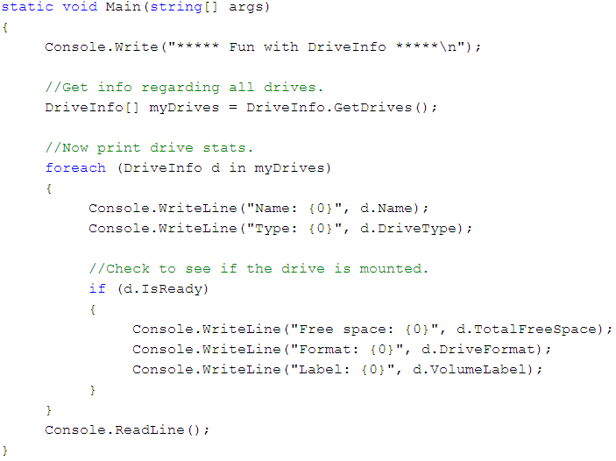
Displaying information of a drive

Slide 5
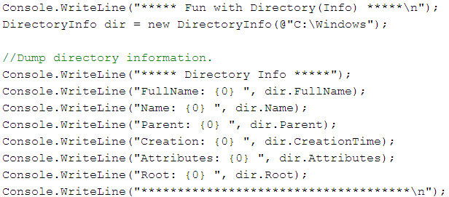
Working with directories
The following example creates a new DirectoryInfo and displays a number of interesting statistics

Slide 6
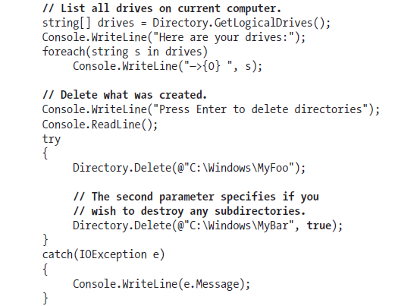
Working with directories
The members of Directory mimic the functionality provided by the instance-level members defined by DirectoryInfo

Slide 7
Displaying information of a file
The FileInfo class allows to obtain details regarding existing files on your hard drive and aids in the creation, copying, moving, and destruction of files

Slide 8
The abstract Stream class
A stream represents a chunk of data
Streams provide a common way to interact with a sequence of bytes, regardless of what kind of device
The abstract System.IO.Stream class defines a number of members that provide support for synchronous and asynchronous interactions with the storage medium

Slide 9
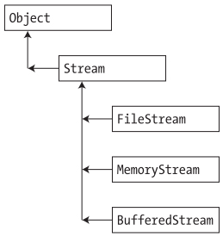
The abstract Stream class

Slide 10
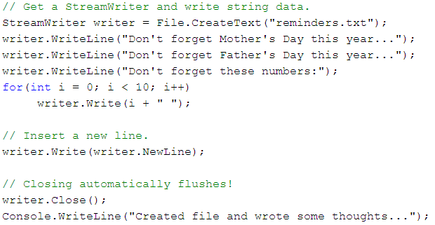
Working with StreamWriters and StreamReaders
Writing to a Text file

Slide 11
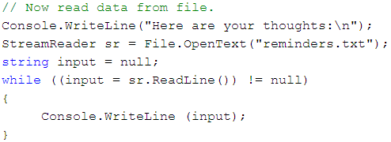
Working with StreamWriter and StreamReader
Reading from a Text file

Slide 12
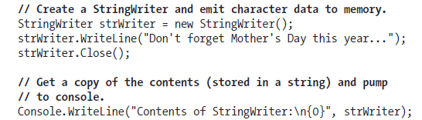
Working with StringWriter and StringReader
Write a block of string data to a StringWriter object rather than a file

Slide 13
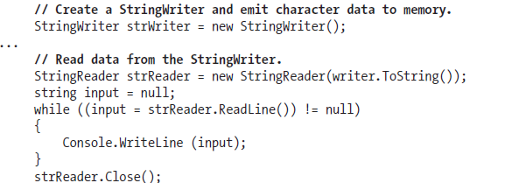
Working with StringWriter and StringReader
Read from a stream of character data from a StringWriter object

Slide 14
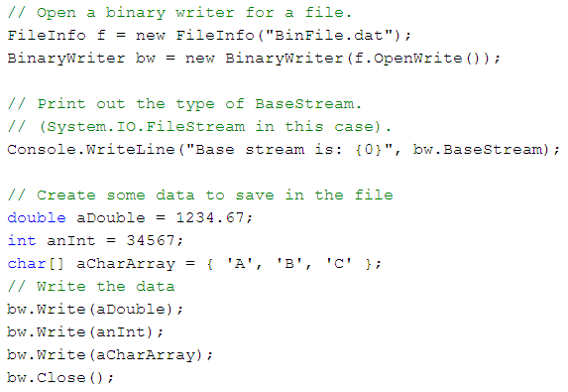
Working with BinaryWriter and BinaryReader
Writing a Binary file

Slide 15
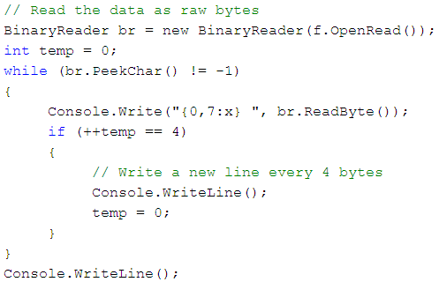
Working with BinaryWriter and BinaryReader
Reading a Binary file

Slide 16
Programmatically "Watching" files
The FileSystemWatcher class can be instructed to monitor files for any of the actions specified by the NotifyFilters enumeration
The first step is to set the Path property to specify the name (and location) of the directory that contains the files to be monitored
  set the Filter property that defines the file extensions of the files to be monitored

Slide 17
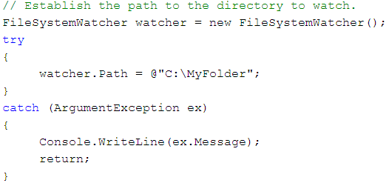
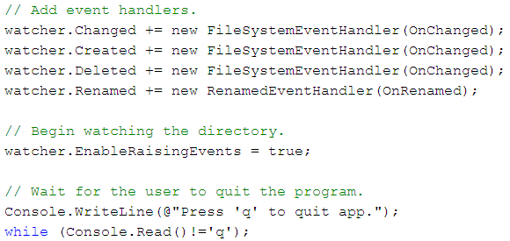
Programmatically "Watching" files

Slide 18
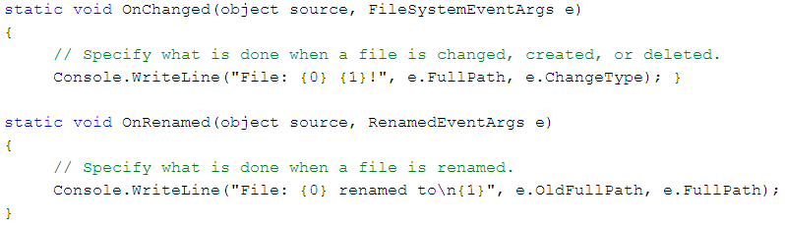
Programmatically "Watching" files

Slide 19
Summary
How to manipulate a physical file or directory
Examining a number of types derived from the Stream class
How to monitor files

Slide 20
Q & A

